Slide 1
Reddit Submissions Analysis Using Web APIs & NLP
A Comparison of Classifiers on Text Data
By: Ayodeji Ejigbo

Slide 2
Table of Content
Introduction
Data Collection
Data Cleaning & Preprocessing
Exploratory Data Analysis
Model Selection
Model Comparison
Conclusion

Slide 3
Introduction
Project Overview: The project involves using NLP and machine learning to classify Reddit posts.
Goal: Classify posts from two subreddits using Natural Language Processing (NLP) and machine learning.
Subreddits chosen:
Soccer
Tennis

Slide 4
Data Collection
Data Source: Reddit
Method: PRAW API (Python Reddit API Wrapper)
Collected posts from Soccer and Tennis subreddits.
Number of posts: 3000

Slide 5
Data Cleaning & Preprocessing
Feature Engineering ( 'text' = 'title' + 'self_text')
Duplicate Rows (Uniqueness)
Tokenization and removal of stop words.
Vectorized Text Data Using Inverse Document Frequency (TF-IDF)
(TfidfVectorizer)

Slide 6
Exploratory Data Analysis
Most Common Words In Each Subreddit
SOCCER
TENNIS
Word | Count
goal | 444
shot | 432
substitution | 425
right | 358
match | 348
club | 333
player | 302
box | 302
league | 286
replaces | 279
Word | Count
http | 576
wimbledon | 571
match | 443
def | 349
play | 319
v | 296
player | 292
win | 289
tennis | 235
think | 212

Slide 7
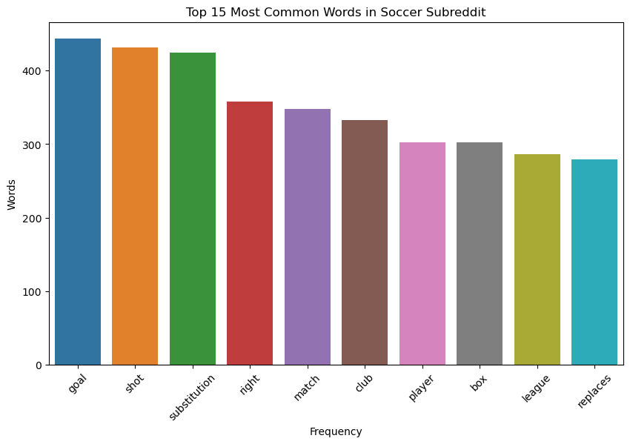
Exploratory Data Analysis

Slide 8
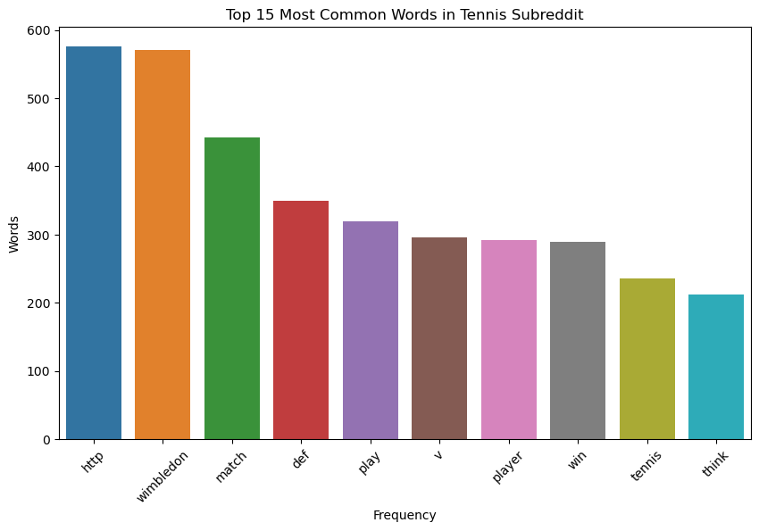
Exploratory Data Analysis

Slide 9
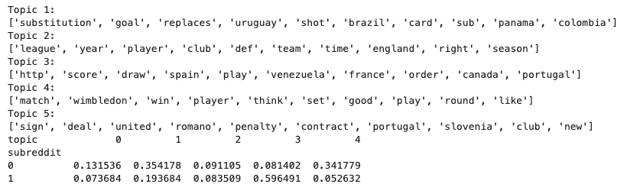
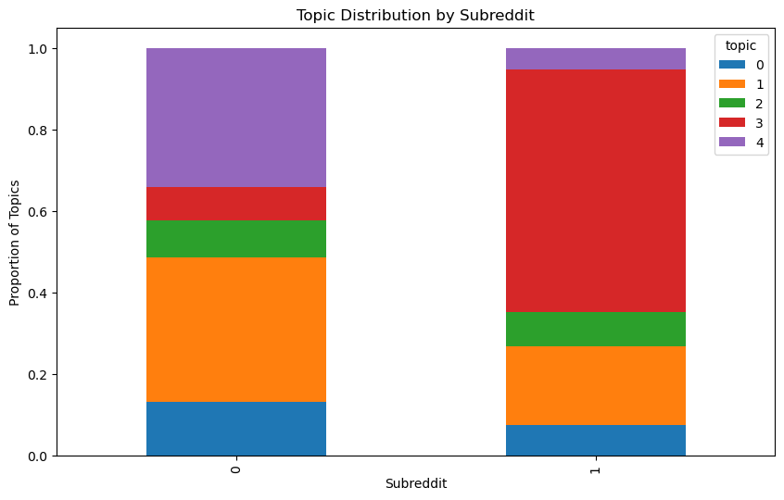
Exploratory Data Analysis

Slide 10
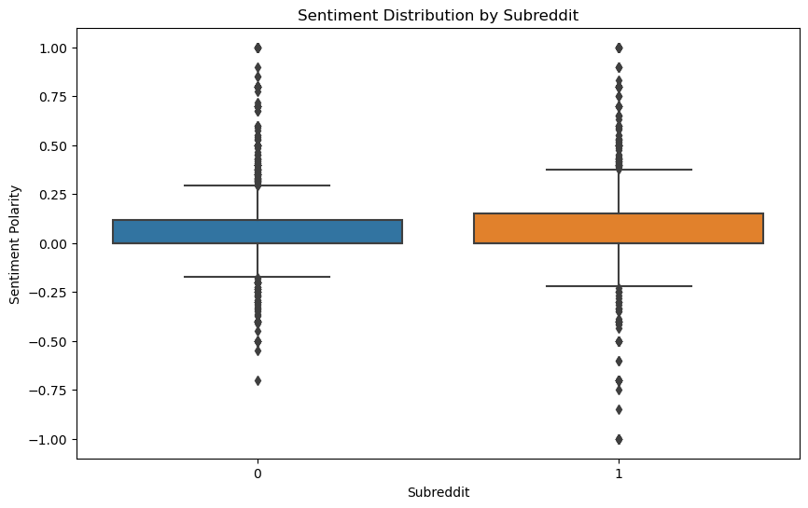
Exploratory Data Analysis

Slide 11
Model Selection
Logistic Regression
Random Forest
SVM
Used GridSearchCV for hyperparameter tuning
Evaluated using cross-validation

Slide 12
Logistic Regression
Cross-validation Mean Accuracy: 94.51%
Standard Deviation: 1.50%
Brief Evaluation of Performance:
Logistic Regression performed well, with a mean accuracy of 94.51%. It is a simple and interpretable model, but it has a high standard deviation.
Confusion Matrix:
Logistic Regression Model Evaluation:
 | Predicted: Soccer (0) | Predicted: Tennis (1)
Actual: Soccer (0) | 382 | 3
Actual: Tennis (0) | 22 | 249
 | Precision | Recall | F1-score
Soccer (0) | 0.95 | 0.99 | 0.97
Tennis (1) | 0.99 | 0.92 | 0.95
Accuracy
96.1%

Slide 13
Random Forests Model
Cross-validation Mean Accuracy: 93.90%
Standard Deviation: 1.47%
Brief Evaluation of Performance:
Random Forest showed strong performance with a mean accuracy of 93.90%. It is robust and handles overfitting well due to its ensemble nature. The standard deviation of 1.47% indicates consistent performance across folds.
Confusion Matrix:
Logistic Regression Model Evaluation:
 | Predicted: Soccer (0) | Predicted: Tennis (1)
Actual: Soccer (0) | 359 | 26
Actual: Tennis (0) | 3 | 268
 | Precision | Recall | F1-score
Soccer (0) | 0.99 | 0.93 | 0.96
Tennis (1) | 0.91 | 0.99 | 0.95
Accuracy
95.6%

Slide 14
Support Vector Machine (SVM)
Cross-validation Mean Accuracy: 96.57%
Standard Deviation: 0.75%
Brief Evaluation of Performance:
SVM outperformed the other models with a mean accuracy of 96.57%. It demonstrated the most consistent performance, as shown by the lowest standard deviation of 0.75%. SVM effectively handles high-dimensional data and performs exceptionally well with text classification tasks.
Confusion Matrix:
Logistic Regression Model Evaluation:
 | Predicted: Soccer (0) | Predicted: Tennis (1)
Actual: Soccer (0) | 381 | 4
Actual: Tennis (0) | 13 | 258
 | Precision | Recall | F1-score
Soccer (0) | 0.97 | 0.99 | 0.98
Tennis (1) | 0.98 | 0.95 | 0.97
Accuracy
97.4%

Slide 15
MODEL COMPARISON
Model | Mean Accuracy | Standard Deviation | Accuracy
Logistic Regression | 94.51% | 1.50% | 96.1%
Random Forest | 93.90% | 1.47% | 95.6%
SVM | 96.57% | 0.75% | 97.4%
Summary:
SVM achieved the highest accuracy and demonstrated the most consistent performance.
Logistic Regression and Random Forest also performed well but were slightly less accurate and consistent compared to SVM.

Slide 16
Conclusion
SVM outperforms other models for this Dataset.
Potential applications for classifying Reddit posts.
Future work:
Expanding to more subreddits.
Exploring additional features.

Slide 17


